Slide 1
Bangla Handwritten Mathematical Expression Recognition
Mizbah Uddin Junaed
Shahnur milon

Slide 2
Introduction
Why this Work?
Related works
Methodology
Result and Discussion
Conclusion
Agenda

Slide 3
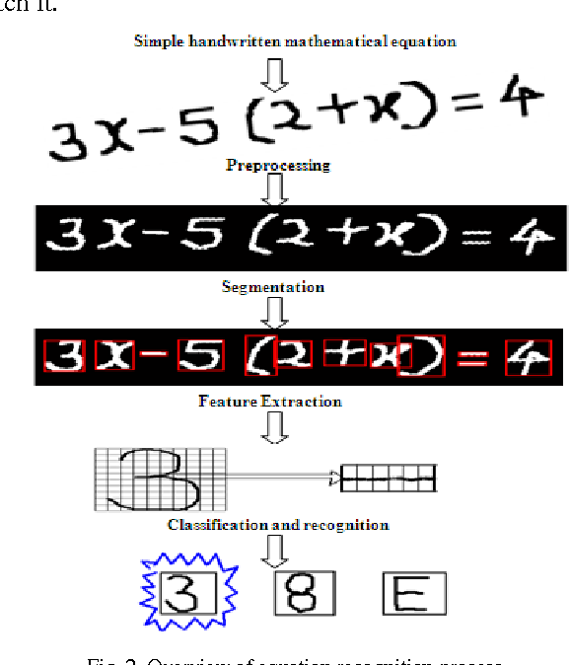
Introduction
Handwritten digits and symbols are challenging to recognise for their diverse shapes and sizes.
Here is an example of english script:
This study aims to address the absence of a dependable model for Bangla handwriting recognition.
We aim to address the absence of comprehensive works for Bangla Script providing more large and diverse datasets

Slide 4
Why this work?
Educational support
Limited Bengali Studies
Language Gap
Empowering students and educators with accurate recognition for effortless learning
Address the scarcity of research in Bengali script, especially in mathematical expression recognition
Bridging language-specific challenges in recognizing complex mathematical symbols

Slide 5
Related works
01
Multilingual focus
Neglects complex characters
OCR-Based Papers
02
Style Diversity
Limited to Digits
Digit Recognition Based Papers
This study aims to address the absence of a dependable model for Bangla handwriting recognition.
03
Complex symbol handling
Limited Bengali Research
Handwritten Expression Recognition Papers

Slide 6
Methodology
01
Data Collection
Added more collected around 5000 bangla handwritten digits and symbols
02
Data Preprocessing
Eliminated noise and ensured quality
Shuffled and split into training and validation subsets
03
Workspace detection
Identified valid rectangular boxes in scanned worksheets
04
Analysis Module
Detected, localized and analysed characters
05
Character Recognise
Utilized DCCNN (Deep Columnar Convolutional Neural Network)
Model trained for many epochs with data augmentation

Slide 7
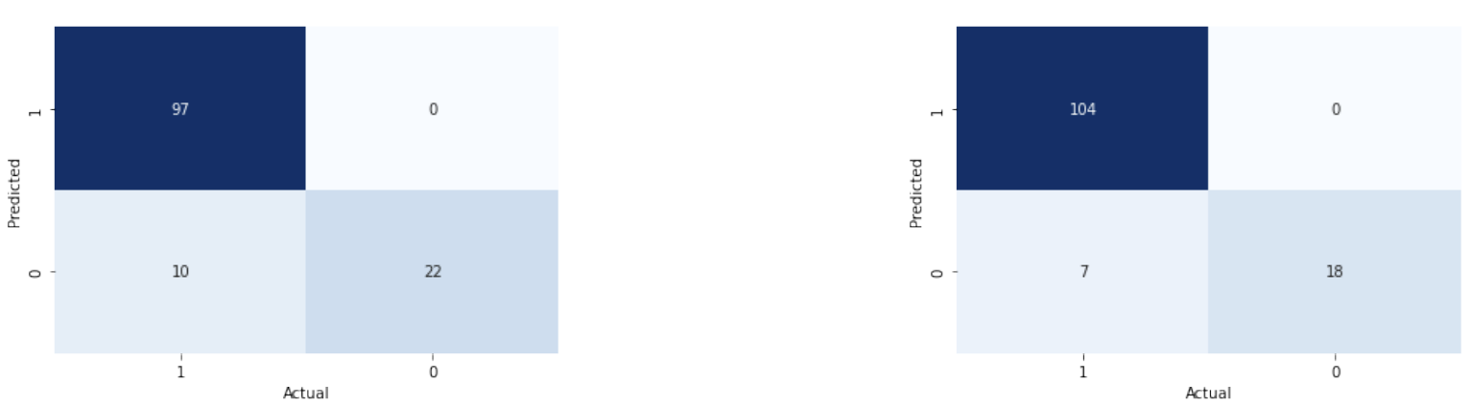
Results and Discussion
Performance metrics
Model | Accuracy | Precision | Recall | F1 score
CNN | 92.25 | 1 | 0.9065 | 0.9510
ResNet-18 | 94.27 | 1 | 0.9369 | 0.9674
Accuracy, Precision, Recall, F1 score

Slide 8
An approach for accurate symbol recognition
Has Educational & Real-World Impact
Accuracy may decrease with unclear or closely spaced expressions
Has potential future research opportunities
Conclusion

Slide 9
Thank You

